Slide 1
Oyster Frame Update (6/1/2020 – 8:00 AM)
Raghav Agarwal

Slide 2
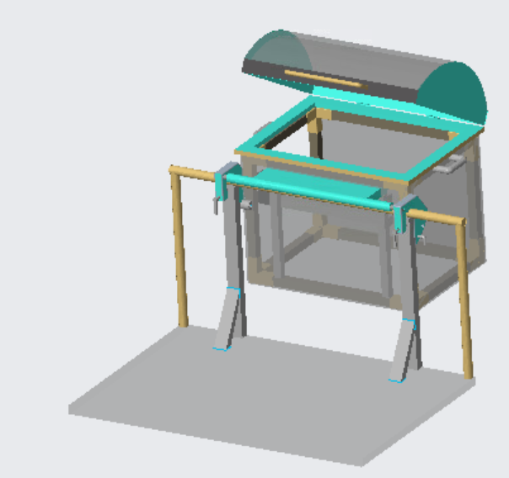
Current Progress
Current parts/assembly files updated to “Oyster_Washing_Shared” 🡪 “Frame” 🡪 “Chayce”
Need to add
Tubing and pump
Lid latches
Legs and wire mesh flooring
Motor/Housing and cage restraints (from Raghav)
Wire mesh front/back (from John)

Slide 3
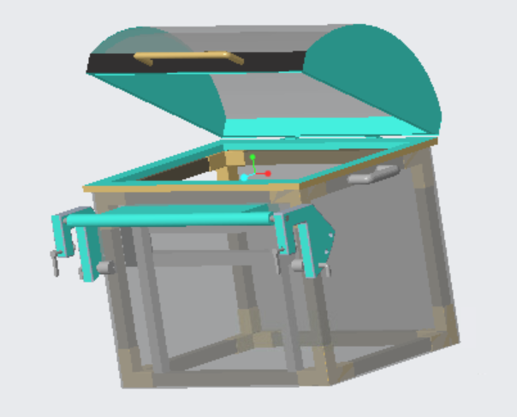
Frame Assembly
Device mounted onto boat railing by two people
Each grasping the two respective handles on their sides; one integrated into the pivot and one integrated into the side of the frame
Red circles indicate the two grasping points for one of the two handlers

Slide 4
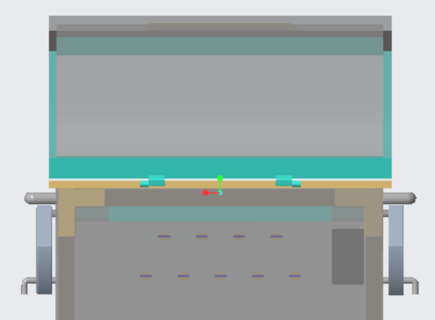
Lid Assembly
Plastic lid with plexiglass sides
Simple hinge on the back of the lid

Slide 5
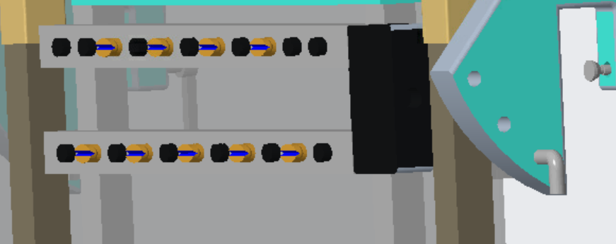
Manifold Assembly
Unsure if this was the exact layout discussed
A top and bottom manifold (positioned at top and bottom of ~5” tall cage; straddles center line)
Plugs indicated in black and nozzles indicated by bronze

Slide 6
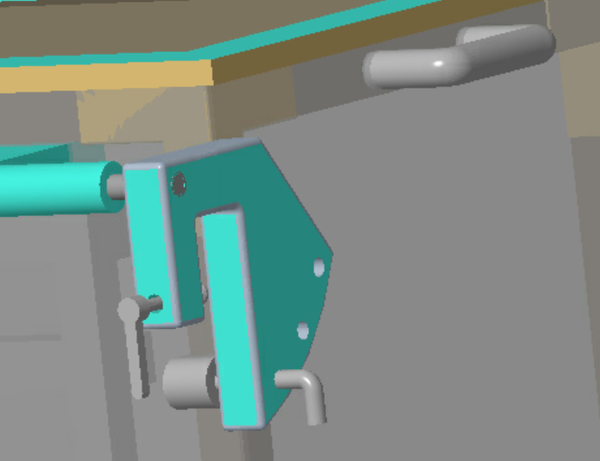
Clamp Assembly
Angles range from 0 – 30 degrees
Angle offset with respect to the vertical orientation of the frame
Simple pin slots to set frame to desired pivot angle
Screw to secure clamp

